Slide 1
Mastering Agile Scrum:
Roles, Artifacts, Events, and Metrics

Slide 2
Presentation Flow
Software Development Life Cycle
SDLC Models
Agile Methodology Overview
Agile Vs Waterfall Model
Scrum Framework
Scrum Roles
Scrum Events
Scrum Artifacts
Memes & Conclusion

Slide 3
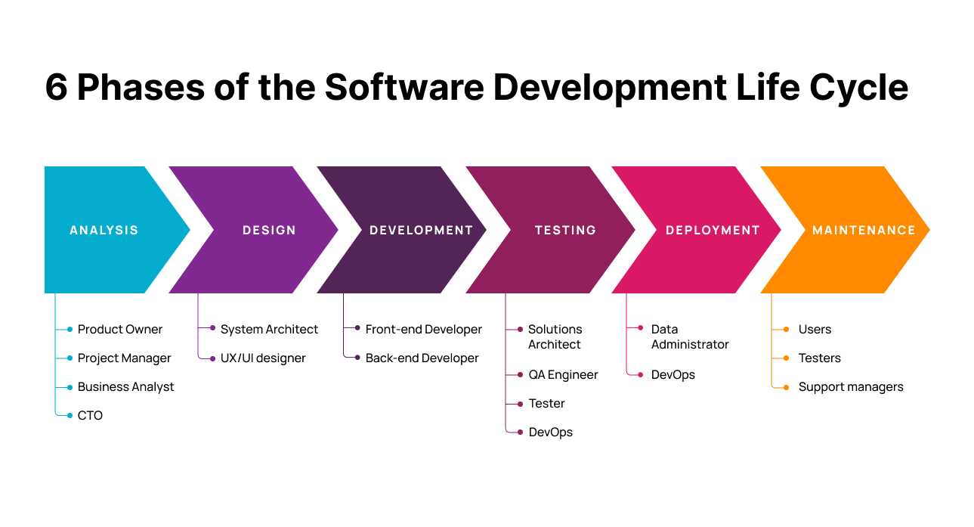
Software development life cycle
The software development lifecycle (SDLC) is the cost-effective and time-efficient process that development teams use to design and build high-quality software.

Slide 4
Software Development Life Cycle Models
Iterative Flow
Agile Model
Linear Flow
Waterfall Model
Spiral Model
V-Model
Most Used
Rapid Application Dev (Rad) Model
Incremental Model
Iterative Model

Slide 5
Agile Model
Agile is an iterative and incremental approach to project management and software development. It is based on the Agile Manifesto, a set of values and principles that prioritize flexibility, collaboration, and responsiveness to change. In an Agile environment, teams work in short iterations called sprints or iterations, delivering working software or product increments at the end of each iteration.
Flexibility
Increased customer satisfaction
Faster time-to-market
Transparency and collaboration
Continuous improvement

Slide 6
Agile vs Waterfall Model
Agile
Waterfall
Its a incremental & Interactive approach to design software
Bugs can be fixed in the middle of the project
The client has early & frequent opportunities to look at the product and make decisions and changes to the project
Agile model is considered unstructured.
Difficult to estimate the project cost and time .
Development of the Software flows sequentially from start to end
Only at the end the whole product is tested
The client can only see the product at the end of the project
It's more Structured as its plan oriented
All sorts of project can be estimated

Slide 7
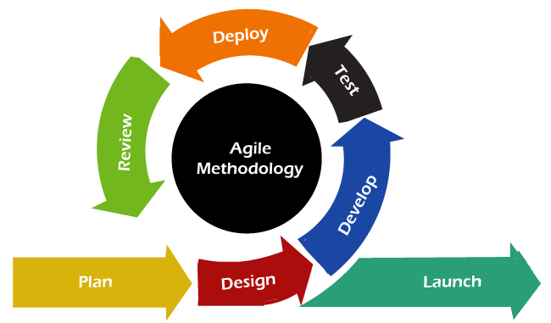
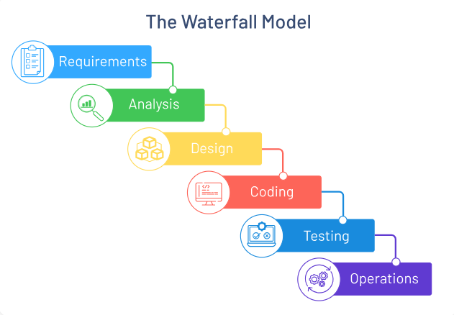
Flow Chart
Sprint 1
Sprint 2
Sprint 3

Slide 8
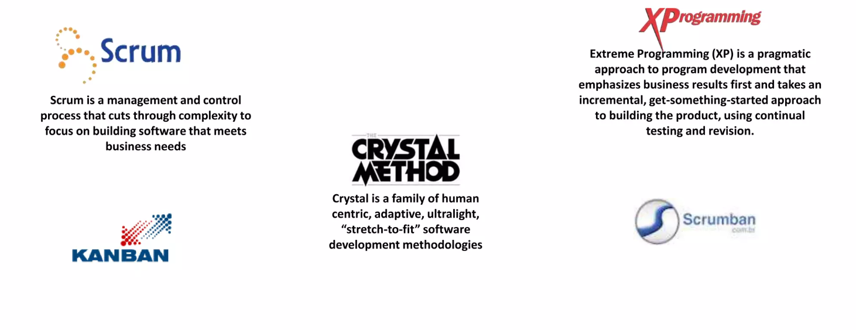
Agile Frameworks

Slide 9
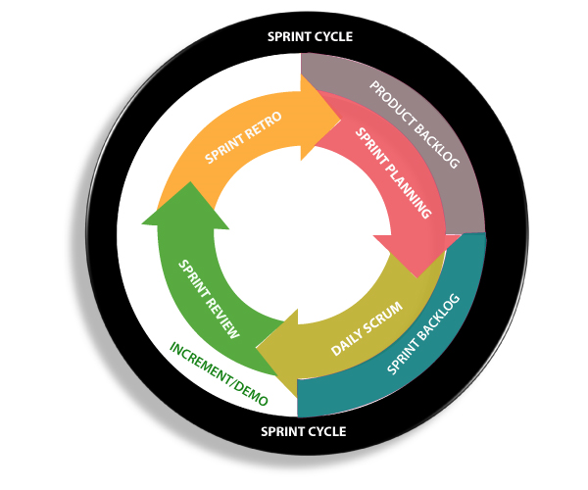
Scrum Framework
Scrum is an agile project management framework that helps teams structure and manage their work through a set of values, principles, and practices. Much like a rugby team (where it gets its name) training for the big game, scrum encourages teams to learn through experiences, self-organize while working on a problem, and reflect on their wins and losses to continuously improve.
Sprints: A sprint is a time-boxed iteration in Scrum during which the Development Team works to complete a set of product backlog items. Sprints typically have a fixed duration, usually ranging from one to four weeks. The duration is determined based on the team's capacity and the project's requirements.

Slide 10
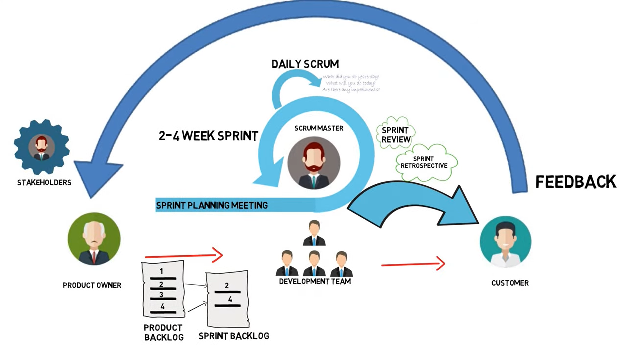

Slide 11



Scrum Roles
Represents the interests of client
Only one person, Responsible for maximizing
the value of the product
Responsible for managing the product backlog
Person who lead the development team & create
a bridge between customer and developer
parties.
Need a wide range of knowledge & Skills,
Sometimes act as a business requirement analyst
Facilitate the P0 & team, facilitate to Scrum
ceremonials
Not a project manager / does not manage the
team, But help to take the decisions
Eliminate any obstacles which restrict the
team when achieving the sprint goal
He / She might be a dedicated full time scrum
master or a team member
Make sure that everything is happening
according to the scrum process
Collaborates with the Product Owner to understand and refine the requirements.
Commits to the Sprint Goal and delivers a potentially shippable Increment at the end of each sprint.
Software engineers, QA engineers,Architectures, UI/UX designers etc.

Slide 12
Scrum Events
Scrum events are the various meetings and ceremonies that take place during a sprint. These include Sprint Planning, Daily Scrum, Sprint Review, and Sprint Retrospective. The Sprint itself is the period of time during which the Development Team works to complete the items in the Sprint Backlog.
Each event has a specific purpose and helps to ensure that everyone is aligned and working towards the same goals. The Daily Scrum, for example, is a short daily meeting where team members share their progress and discuss any obstacles they are facing. This helps to keep everyone on track and identify any issues early on.

Slide 13
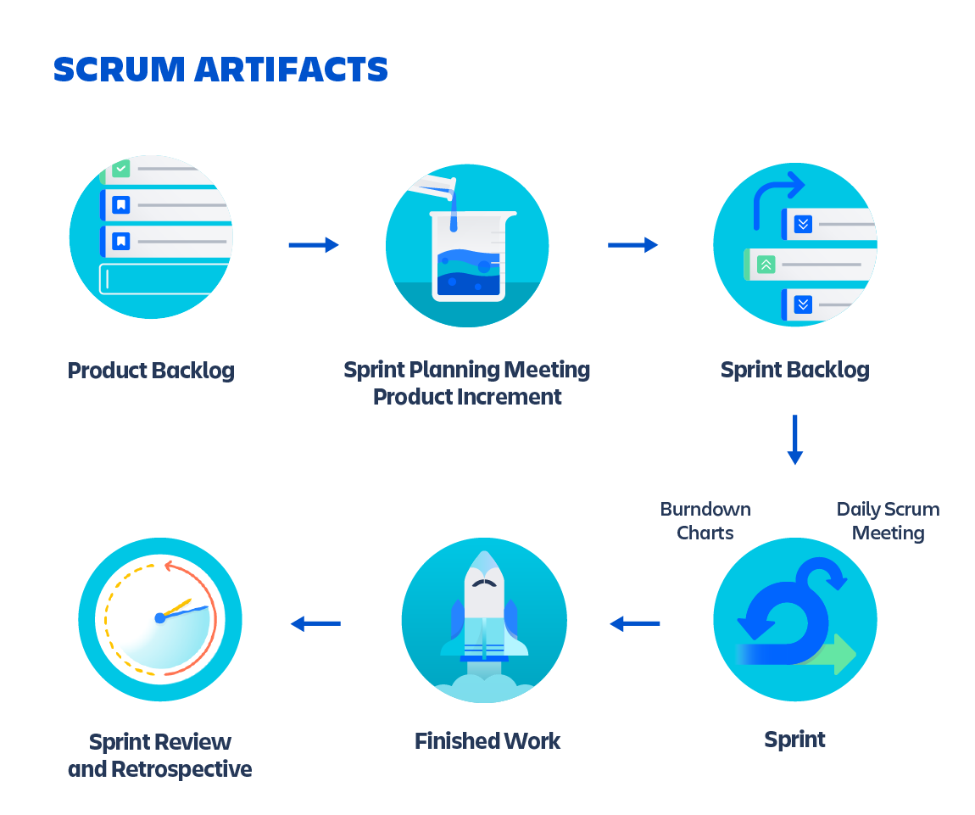
Scrum Artifacts
Scrum artifacts are the tangible outputs of the Scrum process. The Product Backlog is a prioritized list of features and requirements for the product, while the Sprint Backlog is a plan for how the Development Team will deliver the items in the current sprint. The Increment is the sum of all the completed product backlog items at the end of each sprint.
These artifacts help to provide transparency and visibility into the project's progress, ensuring that everyone knows what needs to be done and when. They also provide a clear understanding of what has been accomplished and what still needs to be done.

Slide 14


Scrum Metrics
Scrum metrics are used to measure progress and help teams identify areas for improvement. Velocity is a measure of how much work the team can complete in a sprint, while the Burn-Down Chart shows how much work is remaining over time. The Sprint Goal is a simple statement that defines what the team hopes to accomplish during the sprint.
By tracking these metrics, teams can identify patterns and trends that can help them improve their process. For example, if the Velocity is consistently low, the team may need to re-evaluate their approach or identify areas where they can improve efficiency.

Slide 15

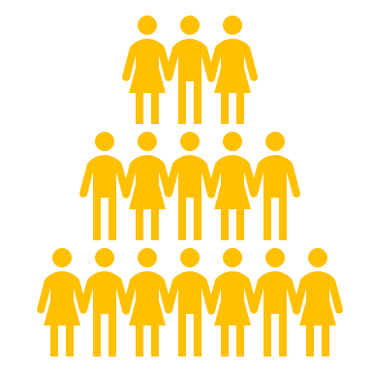
Conclusion
Agile Scrum is a powerful framework that can help teams deliver high-quality products faster and more efficiently. By emphasizing collaboration, flexibility, and continuous improvement, it allows teams to adapt to changing requirements and deliver value to the customer at every step of the way.
By understanding the different roles, artifacts, events, and metrics in Scrum, teams can work together more effectively and achieve better results. So if you're looking to improve your project management process, consider adopting Agile Scrum – you won't be disappointed!

Slide 16
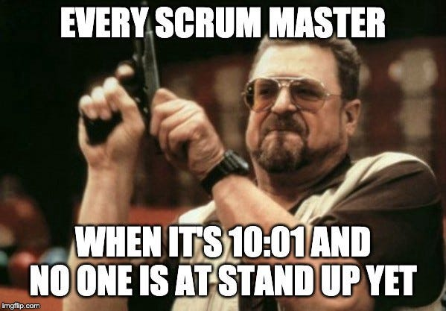
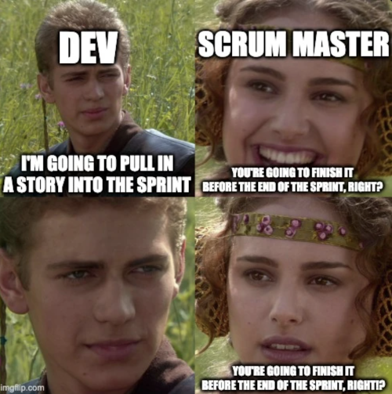

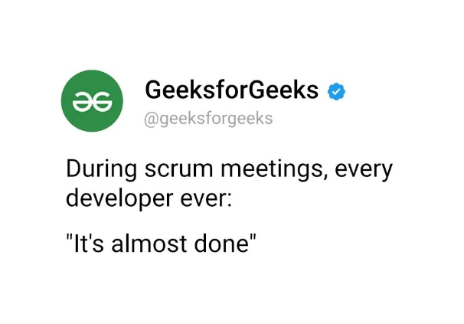
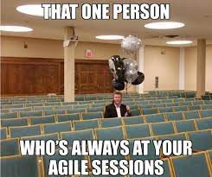
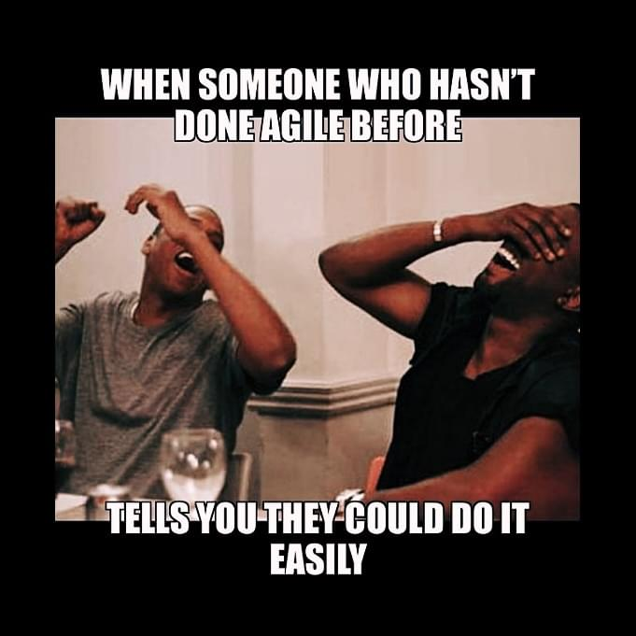

Slide 17
Thanks!
Do you have any questions ?

